Slide 1
WEB TRAFFIC TIME SERIES FORECASTING USING MACHINE LEARNING
Presented By: Under the Guidance of:
Assiya Muskan Mr.Girish L
Ashwini Assistant Professor
Chinmayee R Dept. of CSE
Nayana RS C.I.T, Gubbi

Slide 2
CONTENT
Introduction
Problem statement
Objective
Existing System
Proposed methodology
Results
Conclusion

Slide 3
INTRODUCTION
Recently, more and more people are getting access to the internet all over the world, the rise in traffic for almost all websites are unavoidable.
The increment in traffic for the websites could cause a lot of disputes.
Evaluating web traffic on a web server is highly critical for web service providers since, without a proper demand forecast, customers could have lengthy waiting times and abandon that website.
Many methods have been proposed for forecasting web traffic. The most widely used models are: ARIMA and LSTM.

Slide 4
PROBLEM STATEMENT
Time series can come handy in many problems like analysis, classification and most important forecasting, here we will be focusing on analysis and forecasting.
Here the focus is on predicting future values for multiple time series problem.
Each time series contains daily traffic on Wikipedia page for a total of 803 days from 2015-07-01 to 2017-09-10.
We have a total of 145k time series which means we have data for 145k pages, our goal is to analyze this data, build a model on it and predict future traffic on each of the page for 62 days from 2017–09–13 to 2017–11– 13.

Slide 5

OBJECTIVE
Forecasting future web traffic for approximately 145,000 Wikipedia articles.
The goal of the project is to minimize difference between actual and predicted values.
There are no particular latency requirements, but we should try that it should don’t take hours to predict for a particular date.

Slide 6
EXISTING SYSTEM
LSTM (Long Short-Term Memory):
It is a Recurrent Neural Network (RNN) based architecture that is widely used in natural language processing and time series forecasting.
The LSTM rectifies a huge issue that recurrent neural networks suffer from: short-memory.
LSTMs also help solve exploding and vanishing gradient problems.

Slide 7
ARIMA (Auto-Regressive Integrated Moving Average):
The model has a huge advantage in univariate time series forecasting.
ARIMA model attempts to describe the trends and seasonality in time series as a function of lagged values (Auto Regressive parameter) and Averages changing over time intervals (Moving Averages).
The model includes differencing (Integrating) the original time series data.
The ARIMA equation has two important components Auto-Regressive (AR) part and the Moving Average (MA) part.

Slide 8
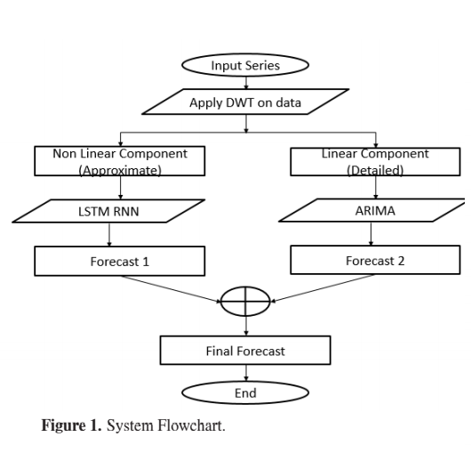
PROPOSED METHODOLOGY

Slide 9
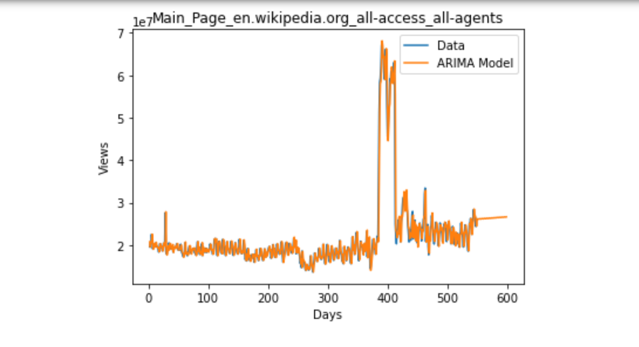
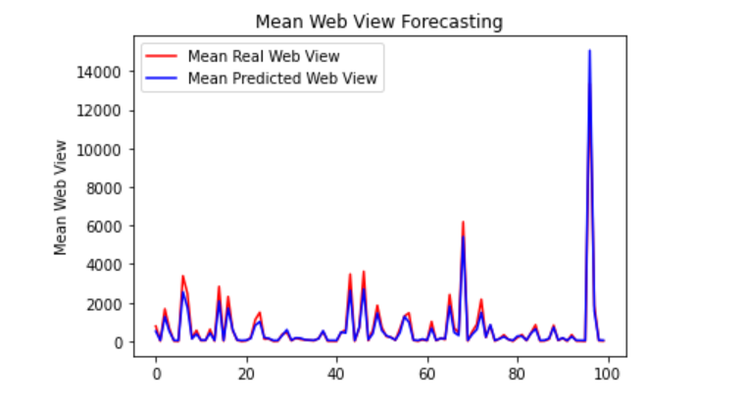
RESULT
Using ARIMA Model Using LSTM Model

Slide 10
CONCLUSION
We developed an model for web traffic forecasting based on artificial intelligence with LSTM and ARIMA for time series forecasting.
Despite the limitations such as dataset with relatively limited data and the unpredictable nature of human behavior, we experimentally verified that the forecasting results of our AI model are pretty accurate and close to the real values.

Slide 11
THANK YOU

